Slide 1
South Fl Audubon Society: Project Perch’s Burrowing Owl Basics Kelly Heffernan Athene Cunicularia Latin Athene = Greek Goddess of Wisdom, she loved owls Cunicularia = miner or burrower All photos by Andy Down, Radpix unless noted otherwise

Slide 2
Bright Yellow Iris Other Iris Colors Seen Brown, Olive or Straw Colored Yellow Bill or Greenish Yellow Bill Brown Upper Parts Heavily Spotted with White or Buff Brown with White Bars Stripes on Back Weight = 5oz or 125-185g < than a ¼ pounder < than a pigeon Photo by Barb Miller
Ground, Billy or Burrowing Owl
Florida’s Owl earns its name, is a hard worker
Regularly dig their own burrows, a true miner
Earth Colored Plumage = Camouflage

Slide 3
Round Head No Eartufts or Earless Whitish Eyebrows White Feathers Along Brow = Eyebrows White Feathers Under Eyes = Mustache White Feathers Across Throat = Collar Underparts Buff-White with Dark Barring Beige with Brown Bars Stripes on Front Long Legs Unfeathered Legs Height = 9” or 18-26cm Photo by Barb Miller
Long-legged Owl

Slide 4
Wingspan = 22”, Long narrow wings, Short tail

Slide 5
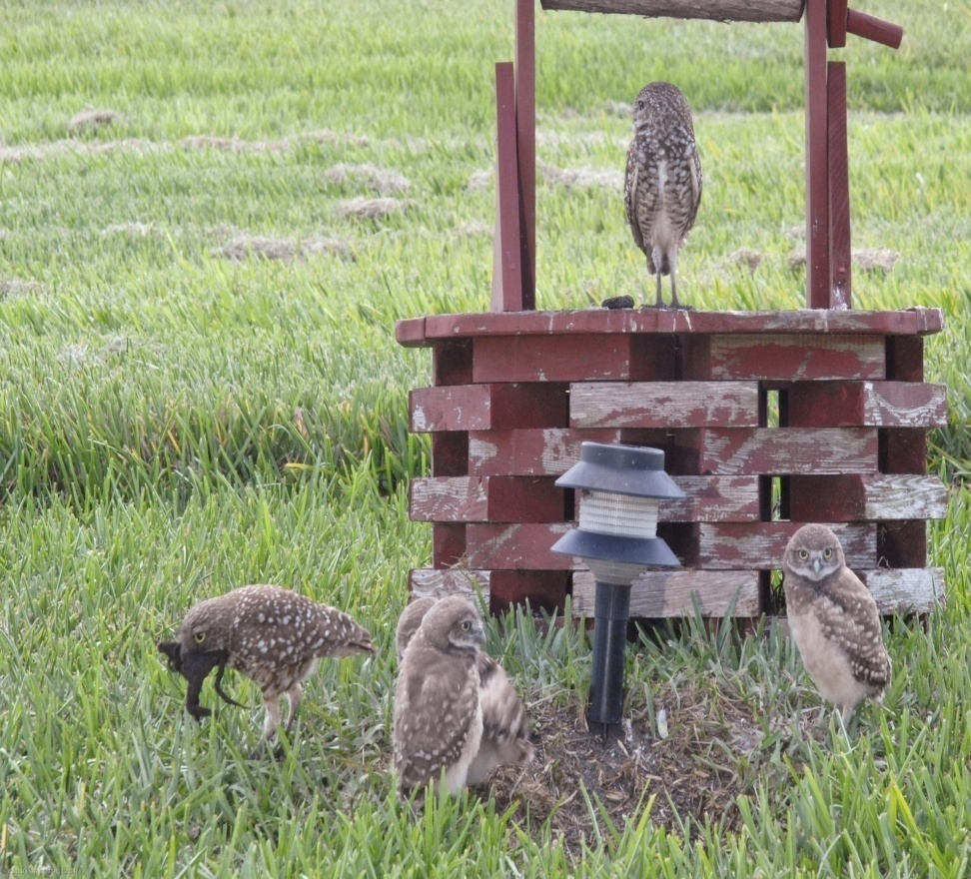
What do owls eat?
They are Florida’s natural pesticide
80-90% insects: grasshoppers, beetles, crickets, crabs, crayfish, toads, frogs, salamanders, lizards, snakes, brown anoles, mice and voles
Crepuscular = hunts mainly at dawn/dusk
Diurnal = hunts as much in the day (insects) as at night (mammals)
Insects are drawn to light/warm pavement

Slide 6
Howdy Owl
Owls have a habit of comically
nodding their heads, so the
Cowboys of the old west
nicknamed them Howdy Owls.
Coo coo = Male’s primary call
Twut twut = Mildly disturbed
Cack cack = Danger
Mimic = can make a noise that
sounds like the rattling or hiss
of a rattlesnake’s tail
Always give owls space!
B Miller, Brian Piccolo Park

Slide 7
Males = Females Little Sexual Dimorphism Only North American Owl Females heavier Males taller, more linear Helps to see owls together Breeding Season February 10 – July 10 Males can look lighter Feathers get sun and the colors lighten or fade “sun-bleached” Compared to Females who stay in the burrow and out of the light

Slide 8
Owls Breed 1 year old or summer after they are born. Short lived = 3-4 years Oldest owl = 9 in wild, 10 in captivity The Eggs 2-11 round white eggs Normally 5-6 eggs Laid every other day Size of a quarter Owls incubate the eggs for 28-30 days Young are born blind and helpless = altricial

Slide 9
The Burrow = 3-15 feet or 3 meters = Home
Owls add dried
plants, feathers,
& mostly dung to their burrow.
Why?
Attract bugs
Incubate eggs,
controls humidity and temperature and CO²
Indicates burrow is taken
= Adaptation
Protects
From
Predators& Weather
Raise Young
Store Food

Slide 10
How do owls grow up?
28 Days = Eggs Incubate
2-3 Weeks = Stay in Burrow Adults Hunt Day and Night
42-45 Days = Young Fledge
4 Weeks = Young Move to Nearby Burrows
5-6 Weeks = Take Short Flights
7-8 Weeks = Longer Flights, Hunt and Dig
9-10 Weeks = Independent

Slide 11
Only owl likely to be seen perched in the open, during the day.

Slide 12
To hunt they walk or run, swoop down from a hover or a perch.

Slide 13
With good perches, owls have high hunting success & survivorship.

Slide 14
What do owls need to do well = survivorship?
Insects, Amphibians
Reptiles,
& Mammals
Open Space
Good Perches
Soil They Can Dig
a Burrow In
Short Sparse
Vegetation
Minimal Disturbance
No pesticides
No herbicides

Slide 15
The risks or pressures that owls face.
Development
Habitat Loss
Marginal Habitat
Vehicle Collisions
Burrows Collapsed
by Lawnmowers
Predation
Feral Dogs & Cats
Natural Predation
Owl Management
Protected Improperly
Grass Not Mowed
2nd Hand Poison
Pesticides
Weather –
Burrow Floods

Slide 16
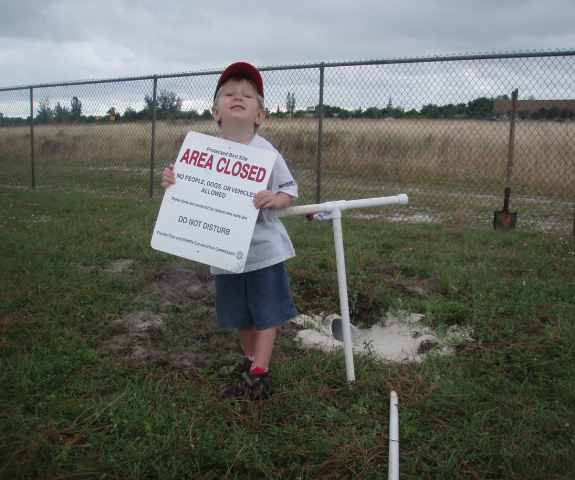
How can we help the owls?
When we see owls, give them space and leave them alone
Protect burrows with simple fences to deter foot traffic
Keep the grass trimmed so the owls have visibility
Mark burrows so they are not run over by large lawn mowers
Install artificial burrows for owls
Do not let anyone bother the owls, tell a teacher or report
Do not use herbicides or pesticides so owls stay healthy
Whispering Pines, Nov 2009

